Slide 1

MICRO PROJECT
“The value of an idea lies in the using of it.”
I B.Tech. 2021-2022

Slide 2










Slide 3




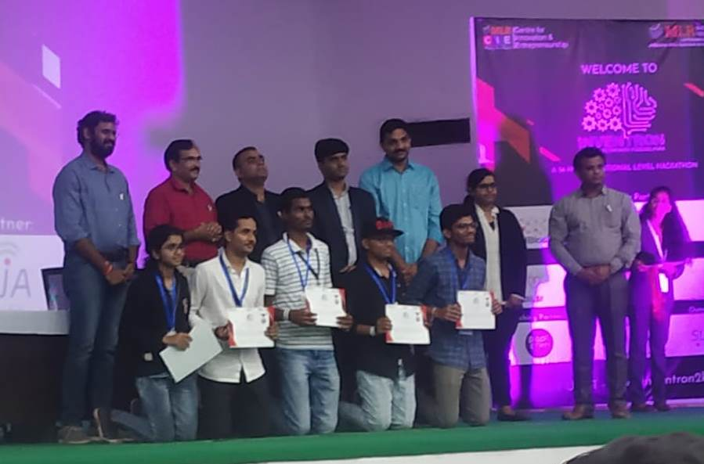

Few Achievements
Certification of Participation
3rd Prize
I B.Tech. Students
I B.Tech. Students
Project title: The Plant Doctor
Project title: Aero Crop
31st July, 2018
29th October, 2017
Technozion-2017
organized by National
Institute of Technology
(NITW), Warangal.
Organized by
Ministry of Skill
Development and
Entrepreneurship(MSDE),
Govt. of India, New Delhi.
Runner-up position
I B.Tech. Students
Project title: Fire Detection using GSM Module
2nd and 3rd November, 2019
INVENTRON 2K19 – National level Hackathon
Organized by CIE, MLRIT.

Slide 4
Micro Project Infographics
Presentation
Prototype
Title of the project
Poster
Power point/Graphics
Title of the project
Abstract
Appropriate Technology (drawings, prototype, other medium) to perform task
Title of the project
Design, SWOT analysis and Action plan
Title of the project
Statement, Purpose, Method and Conclusion

Slide 5

WEEK-1: Introduction
Motivation with PPT
Batch formation
Title identification by the students
WEEK-2: Literature survey and poster presentation
SWOT Analysis
Action plan
WEEK-3: Design of Prototype
Fabrication
Assembly of the model components
WEEK-4: Demo and PPT Presentation
Project evaluation

Slide 6
Abstract Creation must follow
Abstract is an abbreviated version of your project.
Abstract should have the following five pieces:
Introduction: Describe the purpose for doing your project
Problem Statement: Identify the problem you solved or investigated
Procedures: The approach for investigating the problem. Don’t go into details about materials, describe the most important variables if you have room.
Result: The answer obtained. Be specific and use numbers to describe result. (Do not use vague terms like “most” or “some”)
Conclusion: State what the project contributes to the area you worked in. The evidence should support problem statement.

Slide 7
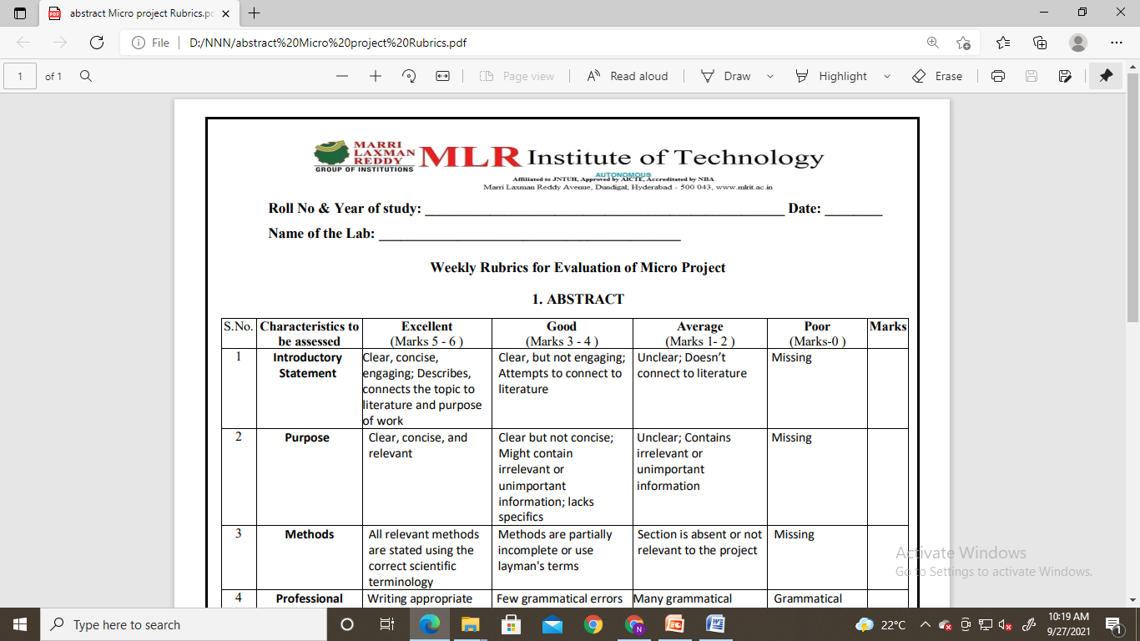
Sample Rubric

Slide 8
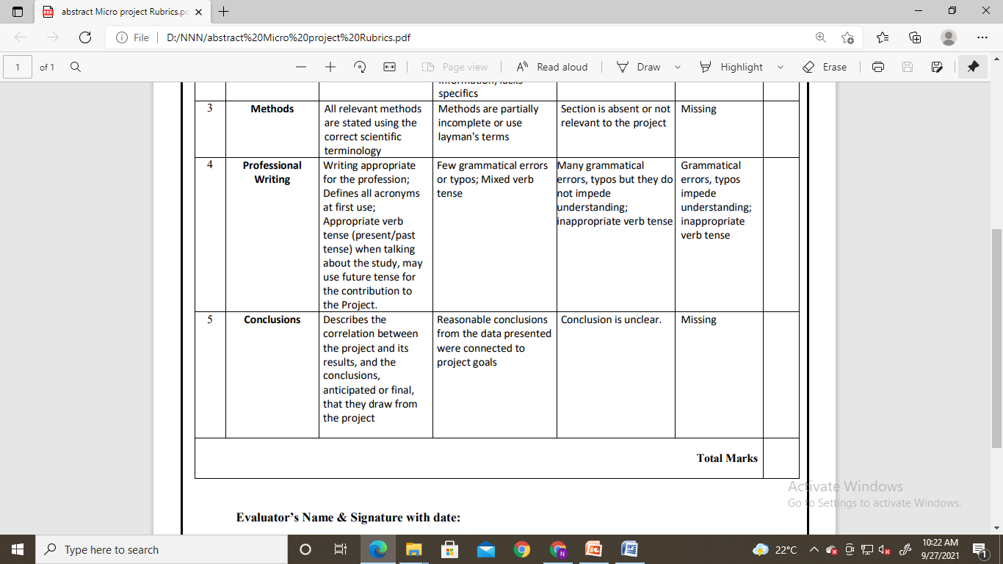
Sample Rubric

Slide 9

Poster should contain the following:
Title of the project
Aim
Vision
Mission
Requirements/Apparatus - Investment
Budget Expected and allocation
SWOT analysis
Action plan(GANTT chart)
Pictures/Details of materials to be used
Model design
Pictures of expected model
Applications

Slide 10
Title of the project
H&S Department, MLRIT
Aim:
Vision:
Mission:
Project requirements:
SAMPLE
Poster Format
Design
SWOT
Action plan(GANTT)
Budget Allocation
(Expected)
Applications
Presented by:
Reference :

Slide 11
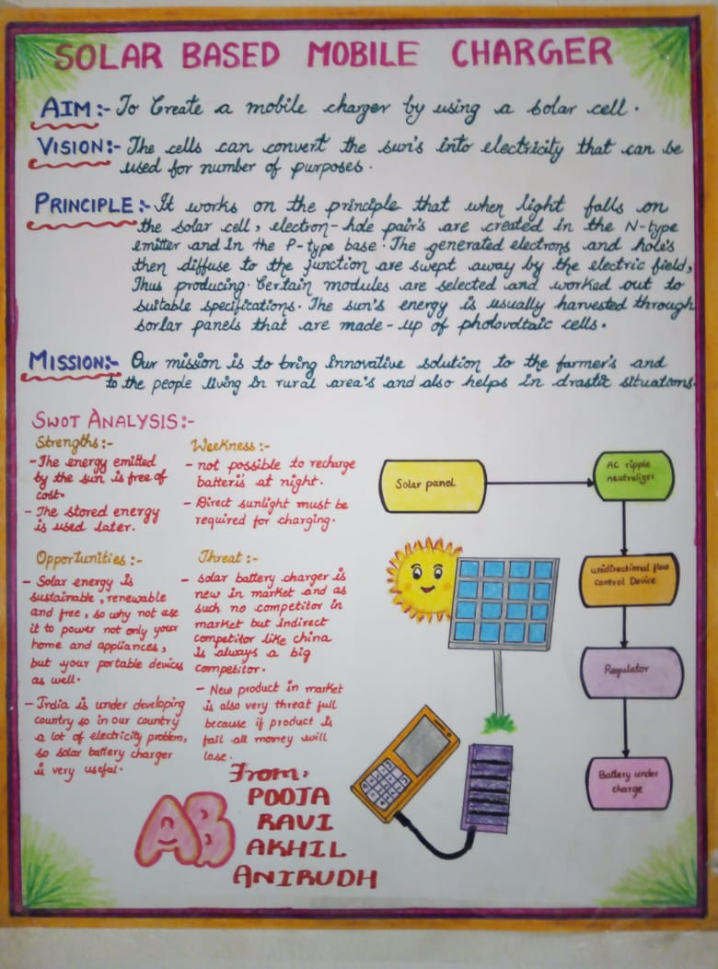
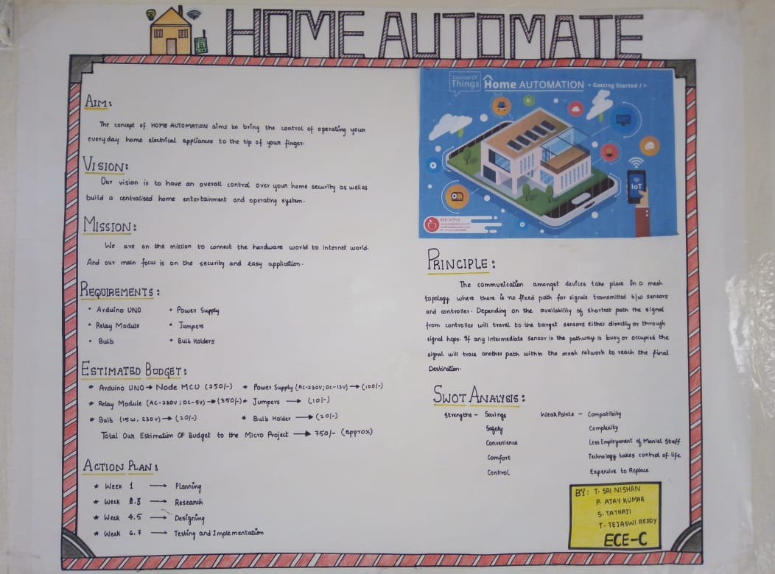
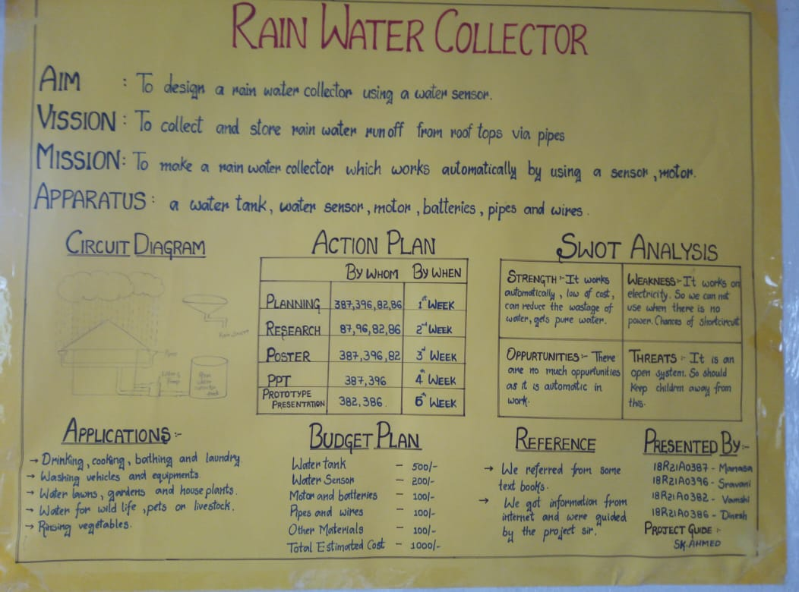

Slide 12


Project Design
Block diagram
A diagram of a framework in which the principal parts or functions are represented by blocks connected by lines
[or]
Circuit diagram
Simple circuit connection of all the devices, indication with terminal names and sings.
Project
Design
[or]
Expected prototype drawing or image
Drawings which are visually communicated how prototype functions or is constructed
[or]
Working prototype model
A preliminary, simple design is created for the project.

Slide 13
SWOT Analysis
STRENGTHS
WEAKNESS
Factors that can generally be controlled, that determine the success of a project.
Weaknesses are internal factors that can make it difficult for a project to succeed.
S
W
O
T
OPPORTUNITIES
THREATS
uncontrollable factors that could help the project succeed. These opportunities may be current but not yet exploited.
external factors that could harm the project if they occur. As with opportunities, they can be current or future threats.

Slide 14
GANTT chart
GANTT chart is a useful graphical tool which shows activities or tasks performed against time. It is also known as visual presentation of a project where the activities are broken down and displayed on a chart which makes it is easy to understand and interpret.

Slide 15
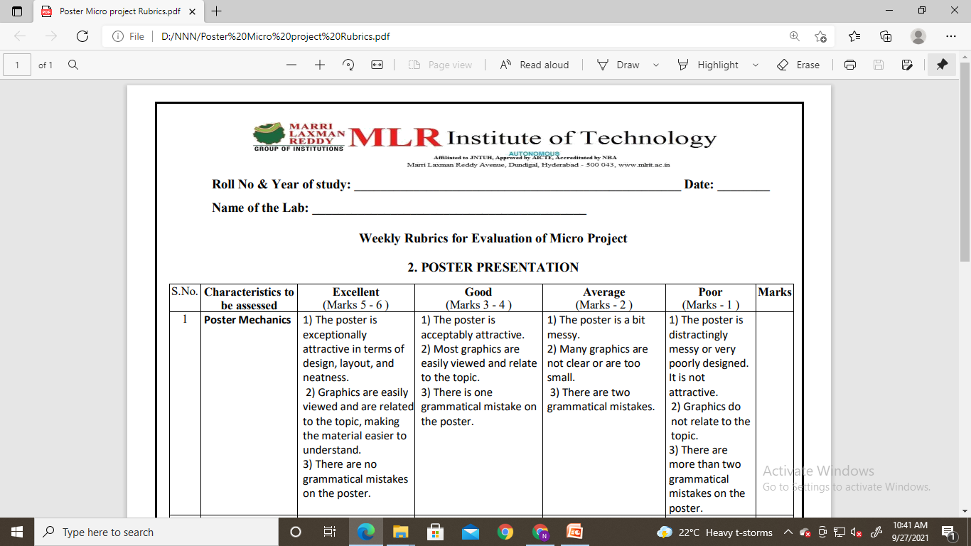
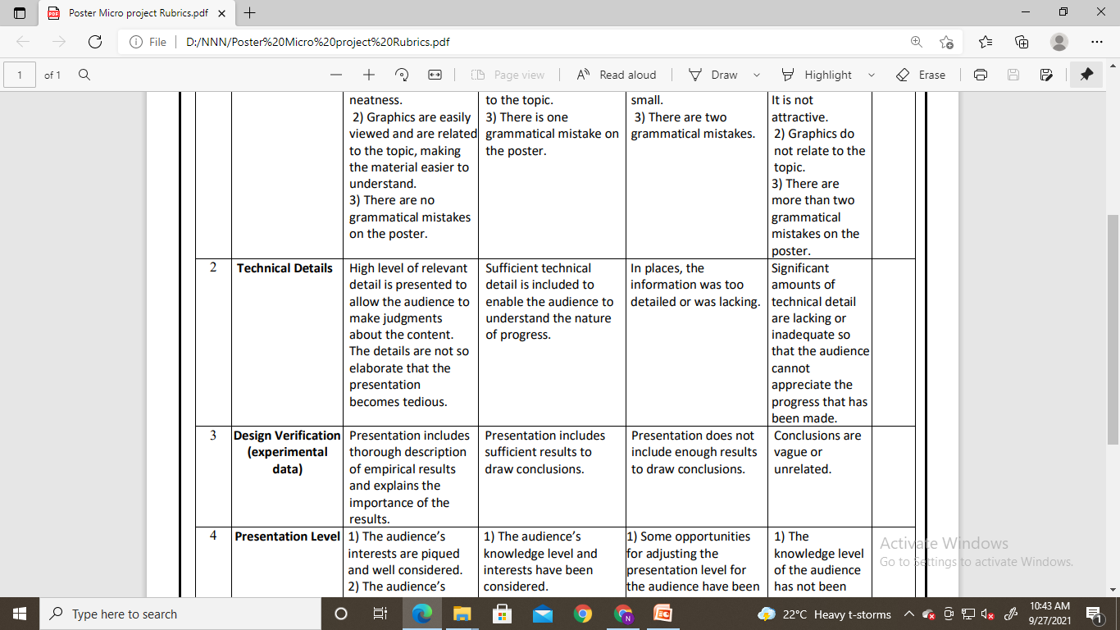
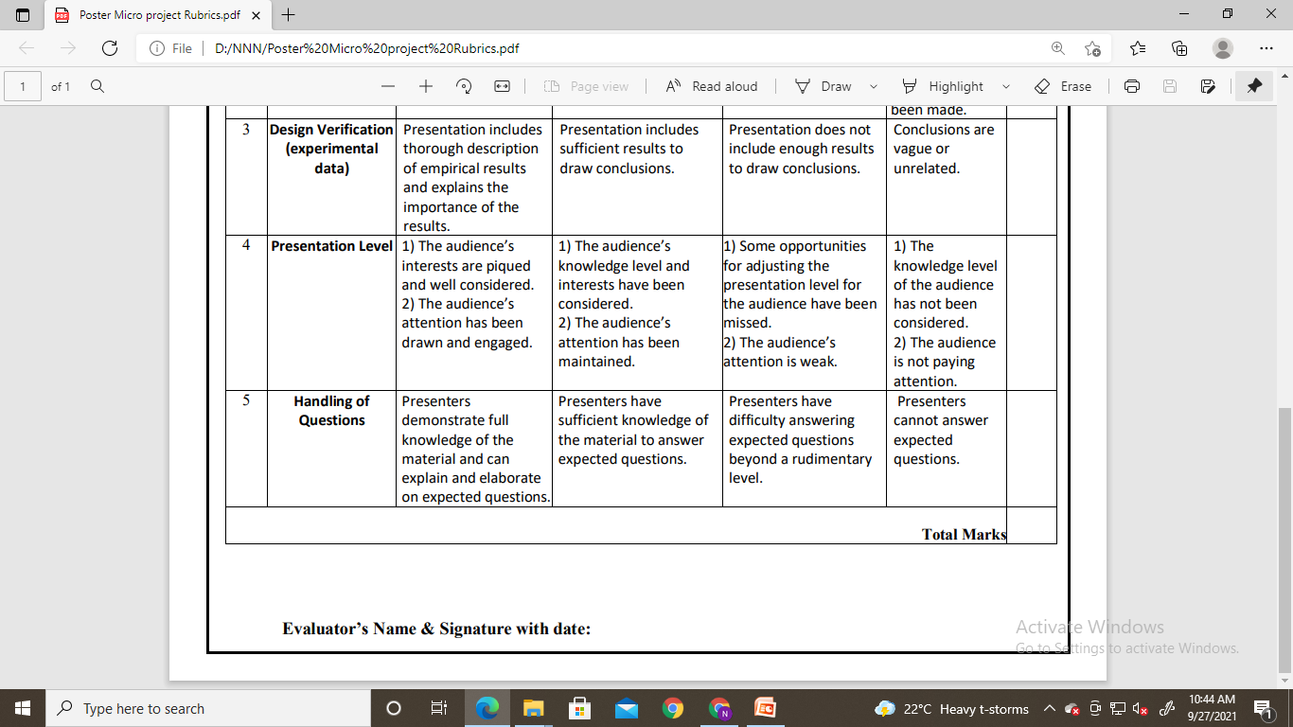
Sample Rubric

Slide 16

Sample Rubric

Slide 17
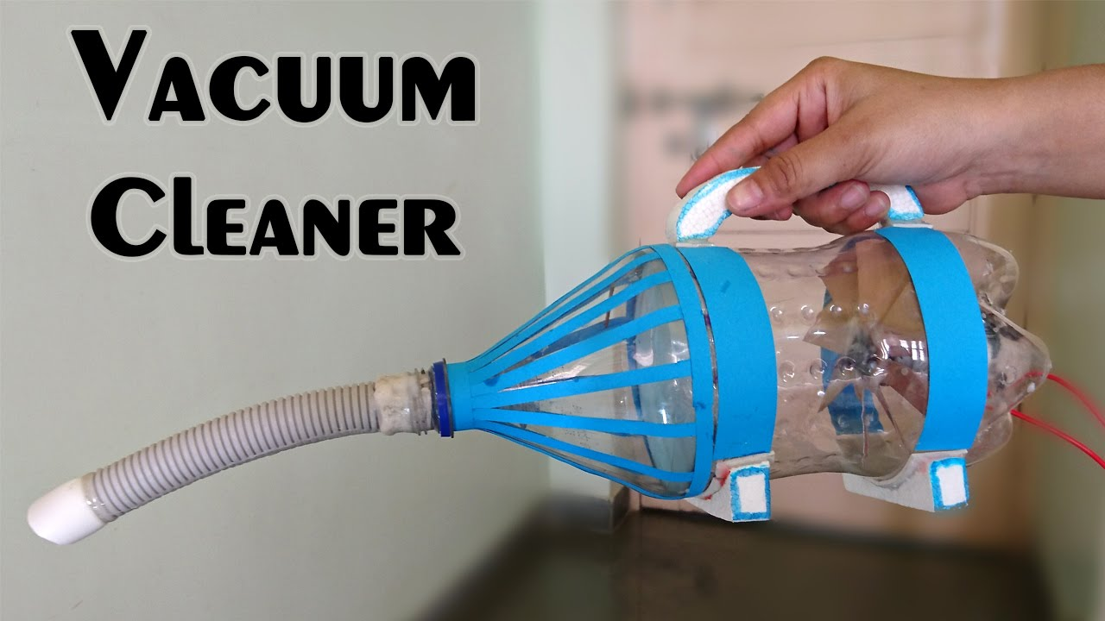
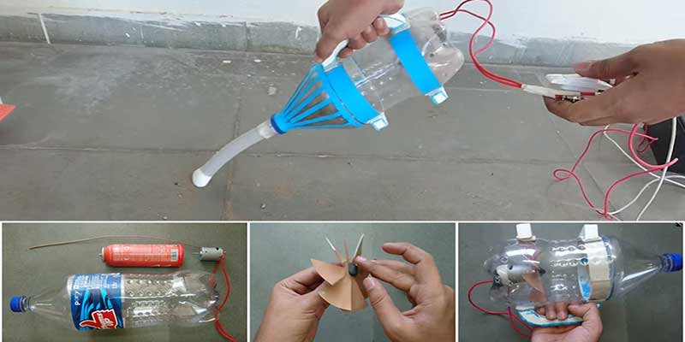
Prototype
A prototype is used to test different working aspects of a product before the design is finalized.
Explain to students the purpose of building prototypes. Mention that several types of prototypes exist, but we will focus on creating prototypes for the purpose of testing different working aspects of a product.
(optional) Ask students the Investigating Questions about creating and testing prototypes.
Allow them to bring in their own if this was established in advance.
Give students "free time" to experiment with the materials and begin construction. Answer questions as they arise.
Have each team show the class their initial prototype, explain its purpose, and describe any challenges they have encountered during the build process. Follow with a class discussion to collaborate in figuring out possible solutions.

Slide 18
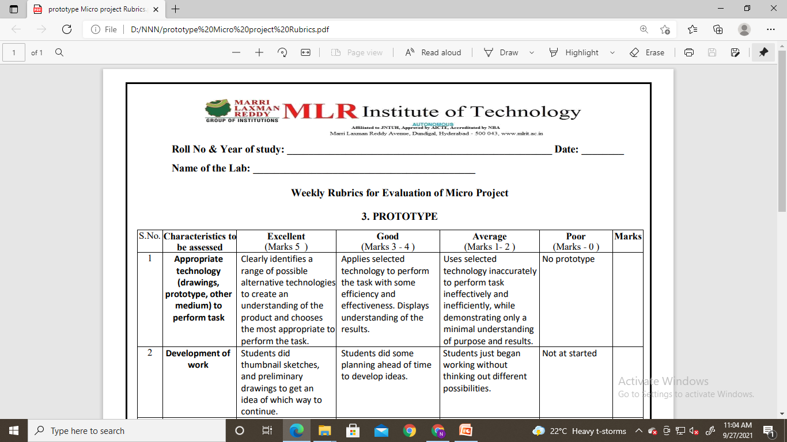
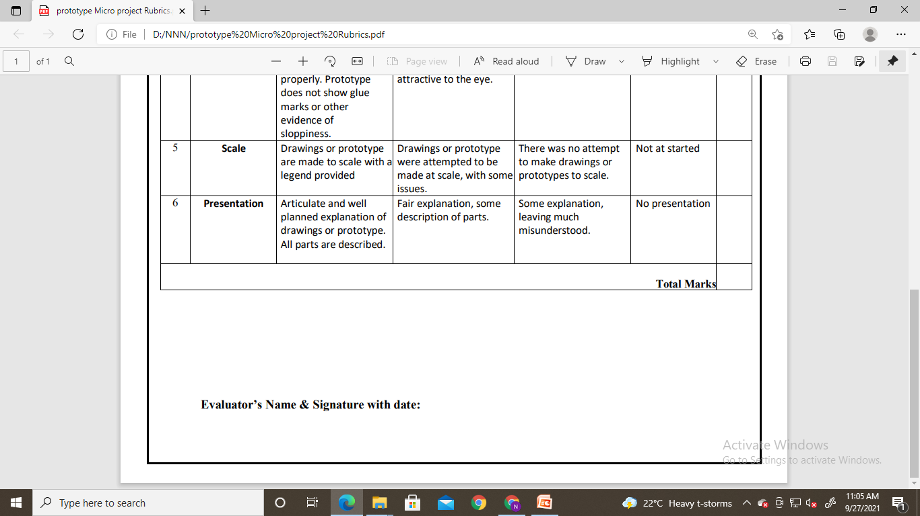
Sample Rubric

Slide 19
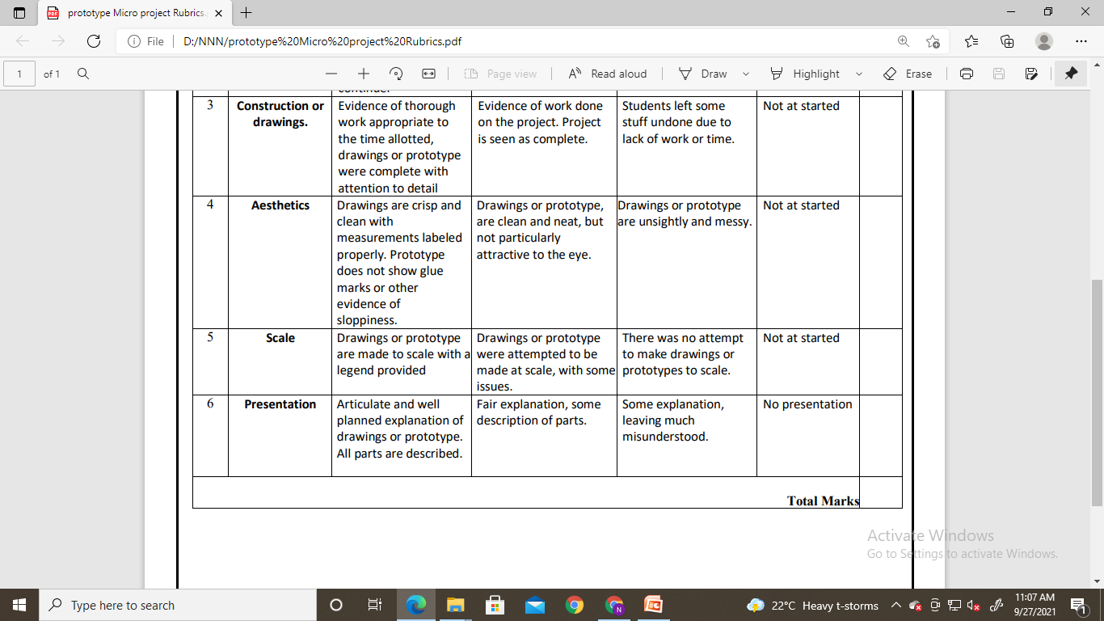
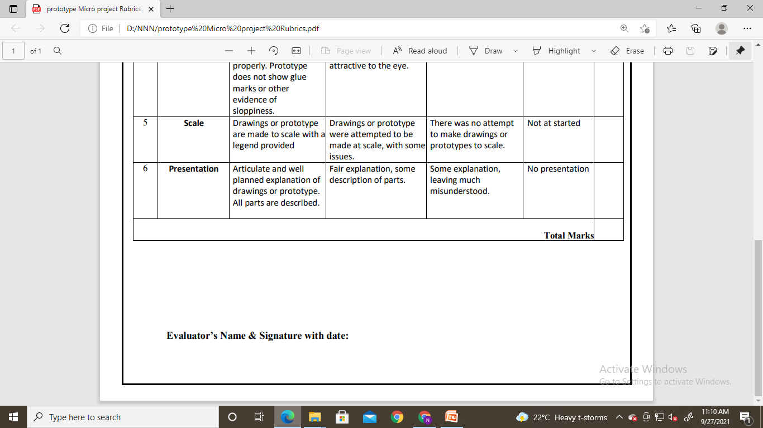
Sample Rubric

Slide 20
PPT Presentation
Detail Explanation about your product.
Be clear with what you want to present.
Start with your aim, end with your references.
Make a colorful and attractive presentation.
Have thorough preparation.
Have demo presentations.
Presenter should have formal and clean look.

Slide 21

Motivation
Vision
Mission
Requirements/Apparatus
Budget
Presentation skill - Marketing
Applications

Slide 22
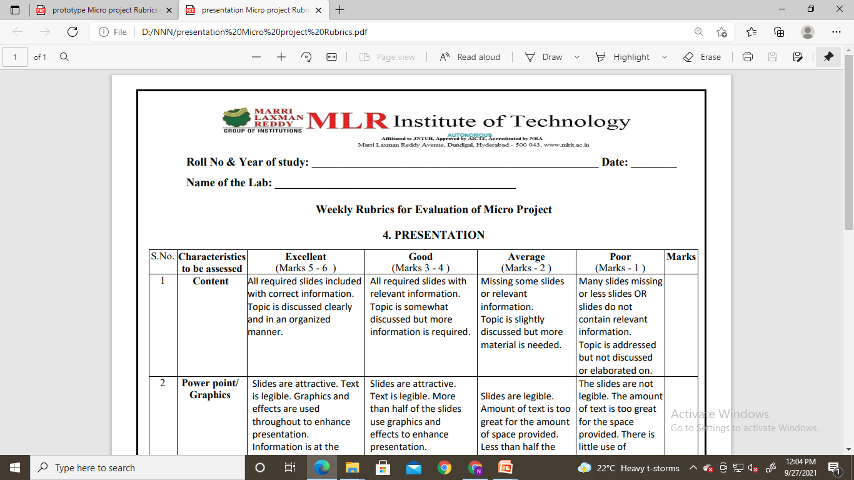
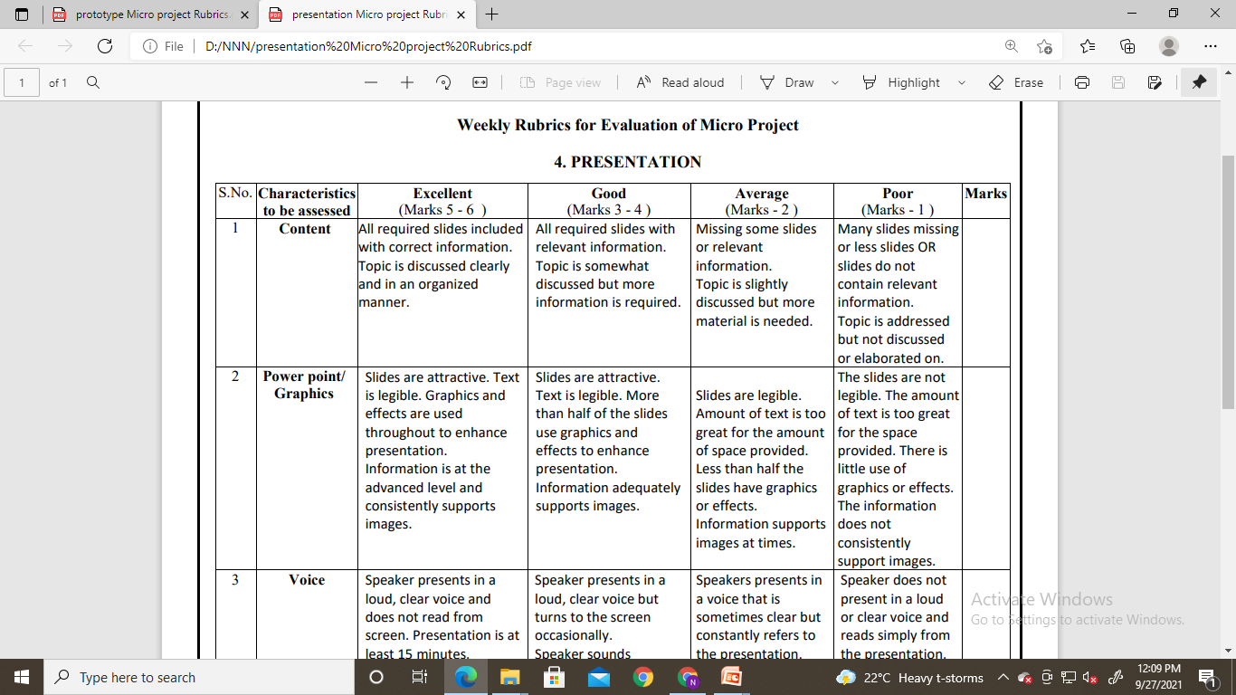

Sample Rubric

Slide 23


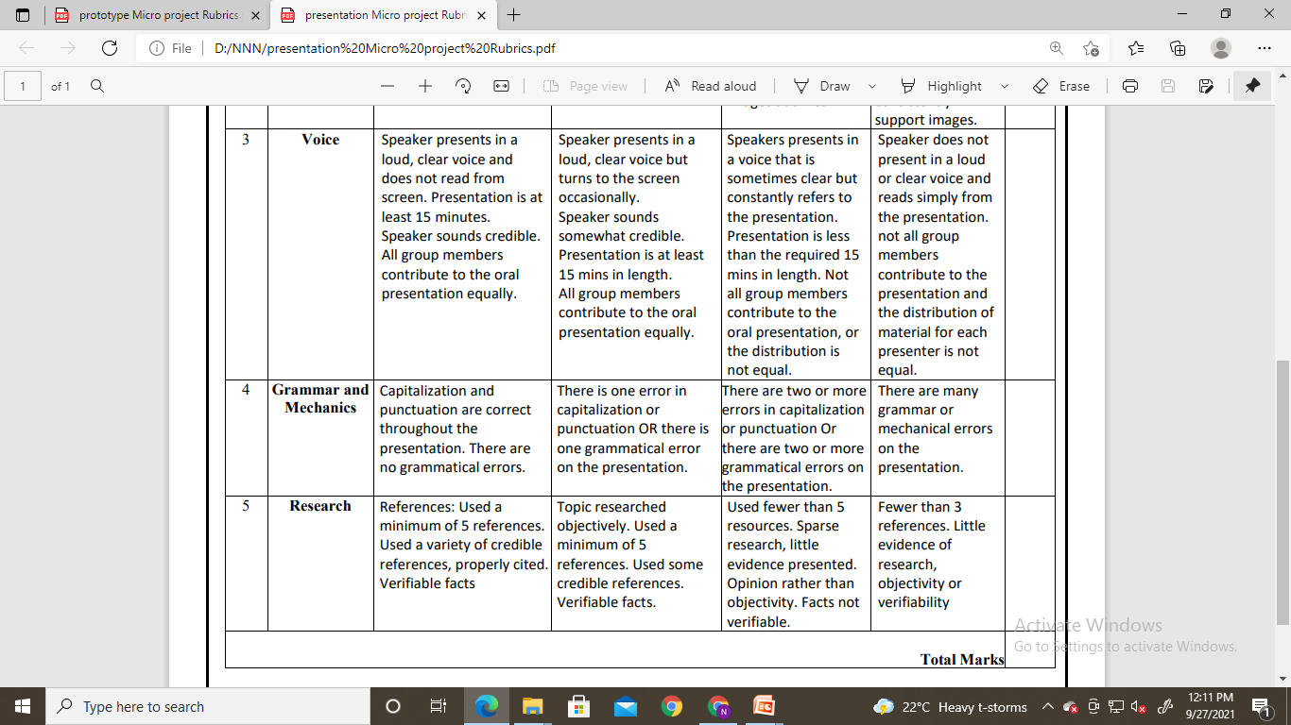
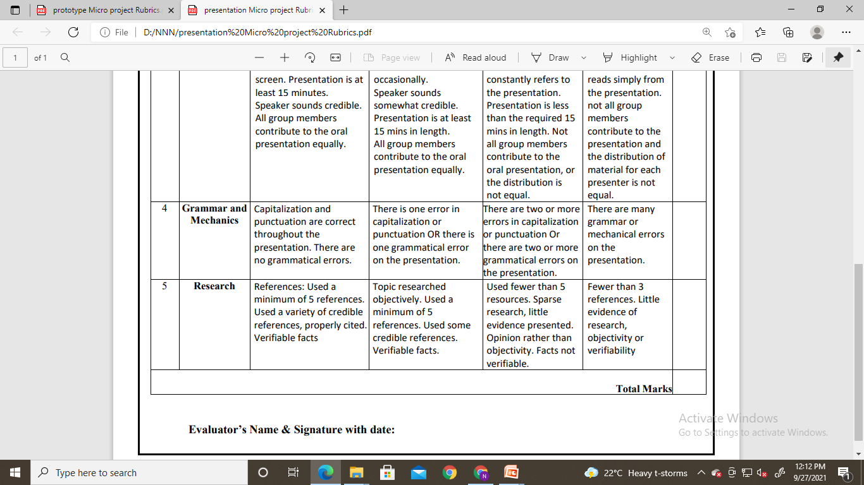
Sample Rubric

Slide 24


Before Choosing Project…!!!
Budget
Knowledge
Duration
Components

Slide 25
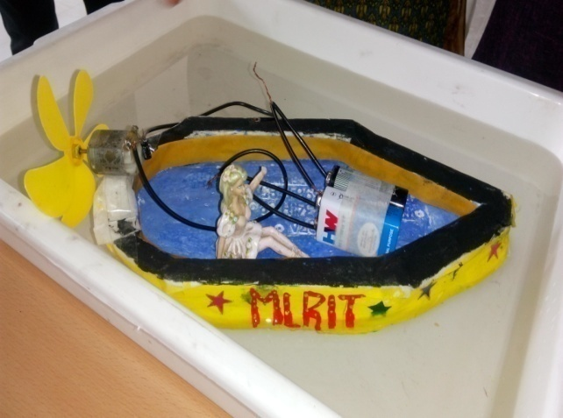
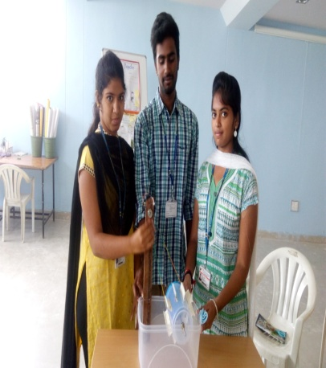
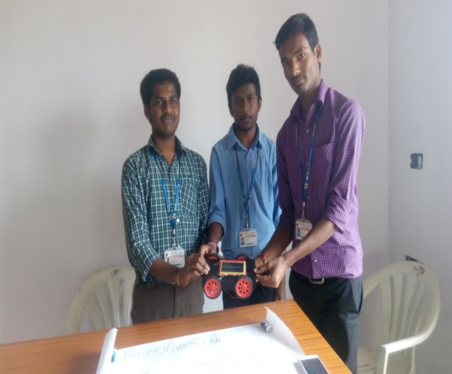
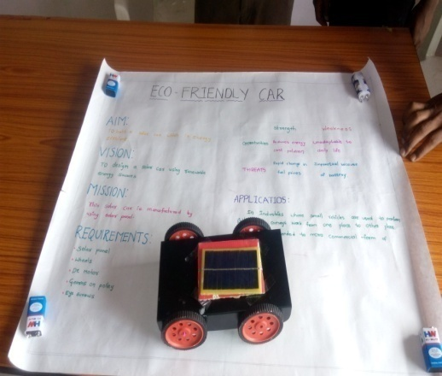
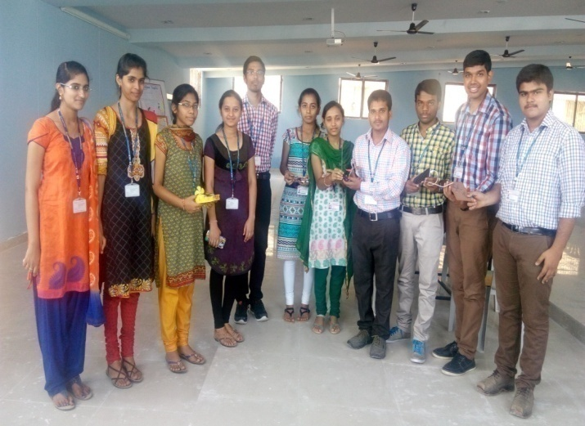
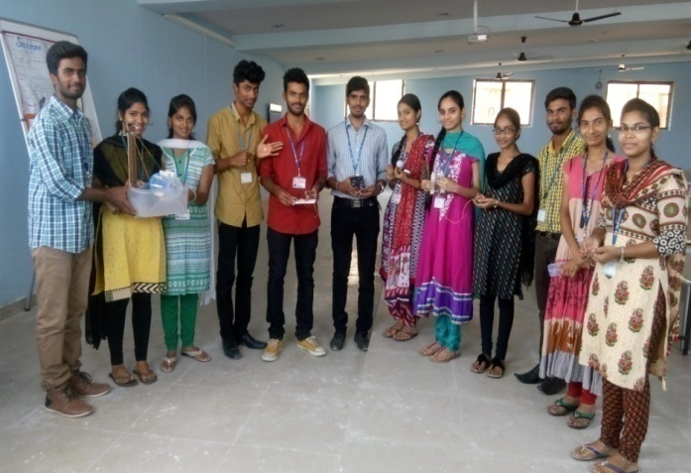
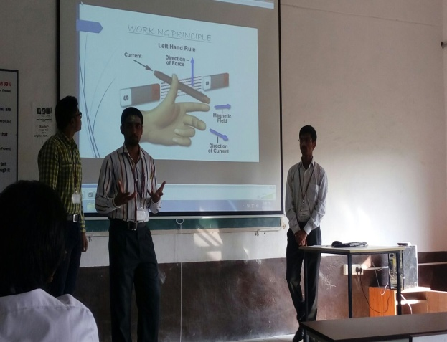
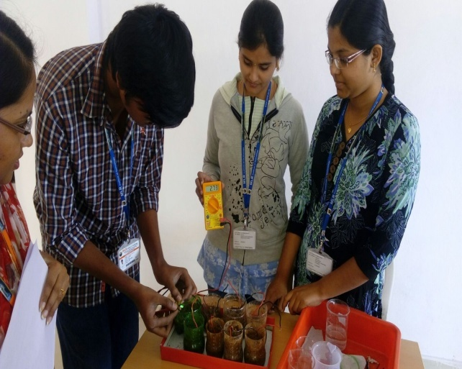
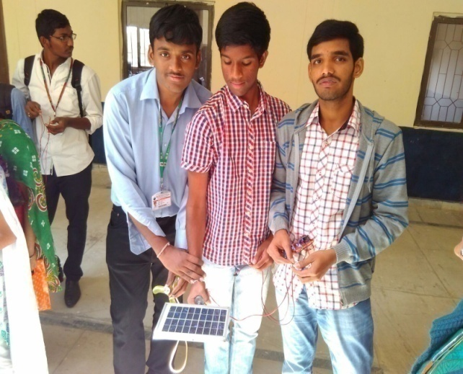
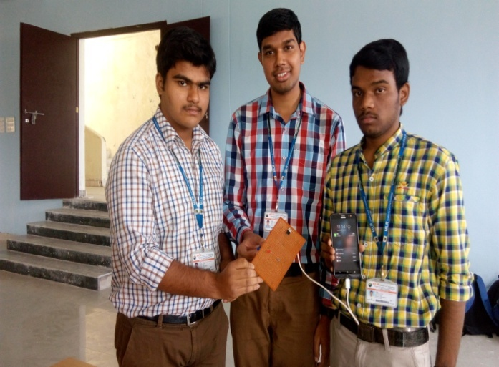

Slide 26


